Slide 1
Crop Production Analysis (Project - 3)
By:
Nithish Bodakunti
Mail Id: nithishbodapunti12@gmail.com

Slide 2
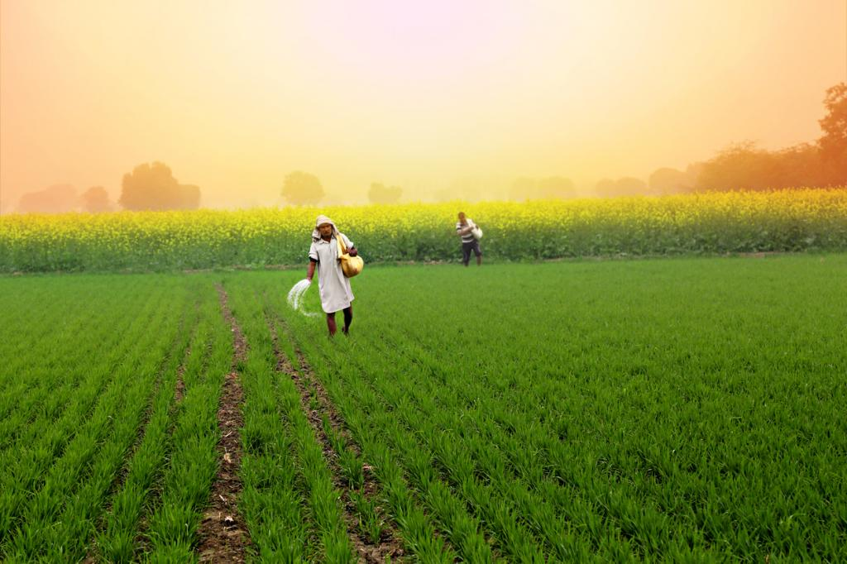
Project Overview
Agriculture business encompasses the economic sectors for farming and its related commerce.
Analysing the Crop Production ensures efficient demand forecasting, supply chain, etc.
Help in collaboration of agri-food sector with different stakeholders of associated business domains efficiently.

Slide 3
Understanding the problem
Item 1
Item 2
Item 3
Getting the clear picture of production and the potential to increase production, helps in planning and decision making in associated businesses.
Understanding the crop division overall and regional wise to have better understanding of resources and demand.
Analysing key relations between attributes and changes in agriculture demographics to have an idea about future sources.

Slide 4
Analysis
Item 1
Item 2
Findings
It is found that Coconut(whole year) crop is produced in very huge quantity mainly in Kerala and Andhra Pradesh and majorly in coastal area.
In the Deccan Plateau region it is observed Sugarcane is dominated crop .
It is found that whole year crops production area to production is less compared to other seasonal crops area to production.
In majority North states Wheat, Bajra, Rice are dominating crops.
Kharif and Rabi crops are highly produced crops in the country in maximum years.
39
4
29
27
4
5
20
35
5
25
22
15
20XX
20XX
20XX
20XX

Slide 5
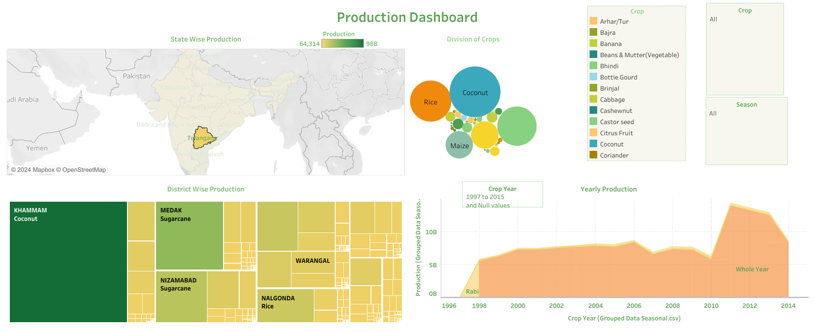
DASHBOARD

Slide 6
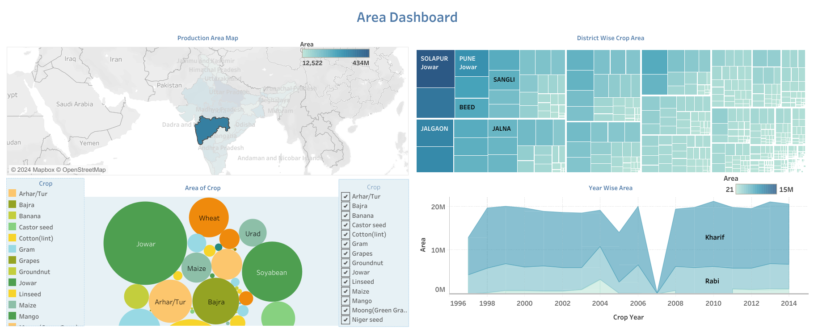
DASHBOARD

Slide 7
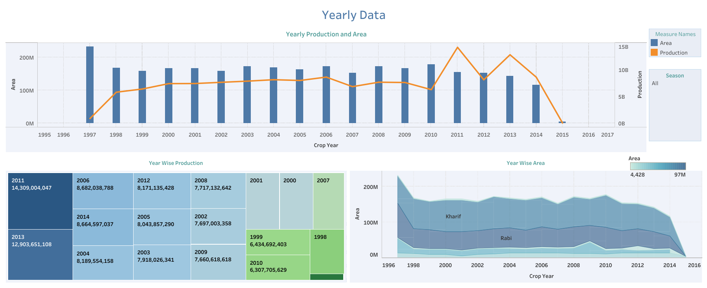
DASHBOARD

Slide 8
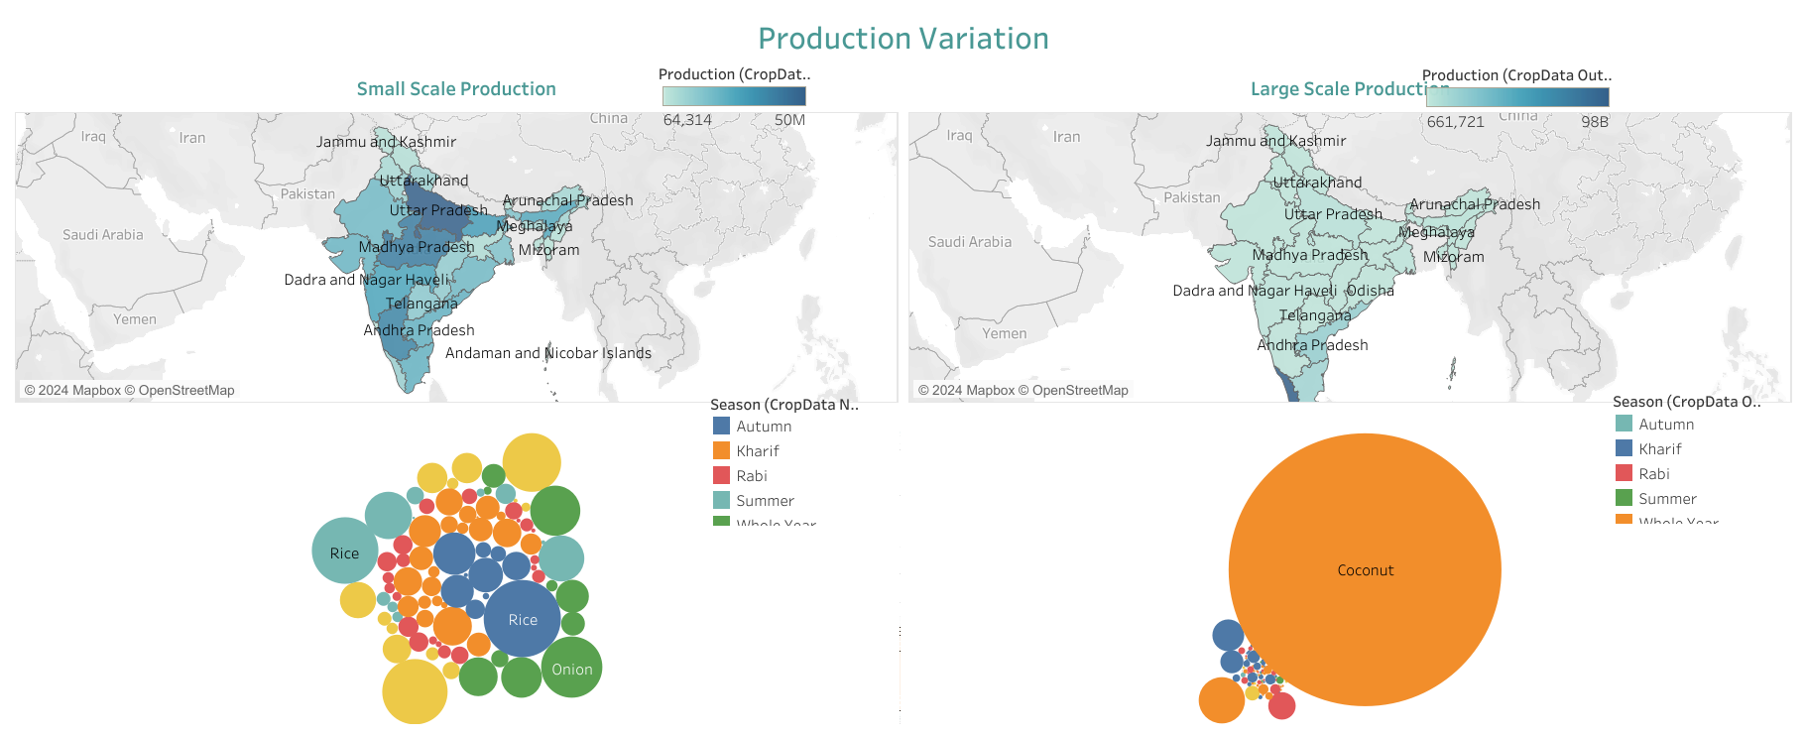
DASHBOARD

Slide 9
Summary
Synopsis 1
Compared to previous years, from 2011 to 2014 are highly productive years but concerning is area is decreasing gradually.
Synopsis 2
Crop production is highly diversified in the country where every state has its own diversification and has its own major crop as per demands and demographic feasibility..
Synopsis 3
The increase in production is positive sign and the same production is expected for upcoming years if measures are taken to maintain same production area is maintained.
Synopsis 4
All states are not equally capable to produce highly throughout year except states having geographical advantages like rivers..

Slide 10
THANK YOU

